Slide 1
California School Performance
General Assembly Data Science
Libby Kocha

Slide 2
80%
of California Schools did not meet 50% math proficiency in 2015.

Slide 3
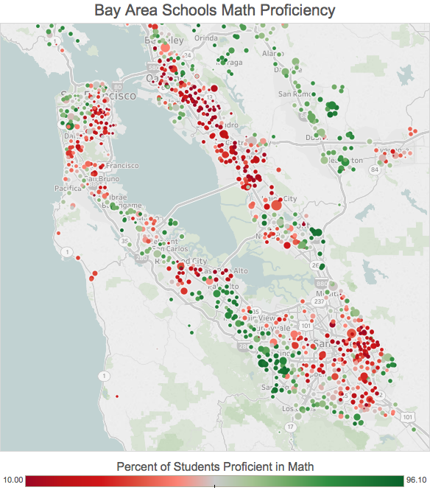
Performance is not evenly distributed.

Slide 4
Why are some schools successful?
Agenda
The data
Exploratory analysis
Regression
Classification
Conclusion & next steps
An analysis of California schools

Slide 5
the data

Slide 6

the data sources
California Department of Education Reports:
Public Schools and Districts (2014-15 School Year)
Staff Demographic Data (2014-15 School Year)
Graduate by Race and Gender (2014-15 School Year)
Student Poverty FRPM (2014-15 School Year)
AYP (2014-15 School Year)
Academic Performance (2013)
Population Studies Center for Social Research
Median Income by Zip Code (2010 Census)

Slide 7
the features
Total enrollment
School type
School grade levels
School funding
School location
School Truancy Rate
Use of virtual learning
Student free meal plans
ARP criteria met
Student ethnicity
Student ethnicity
Student gender
Staff ethnicity
Staff gender
Staff education level
Staff years experience
Math students tested by ethnicity
Math students proficient ethnicity
English students tested by ethnicity
English students proficient by ethnicity
And more...

Slide 8
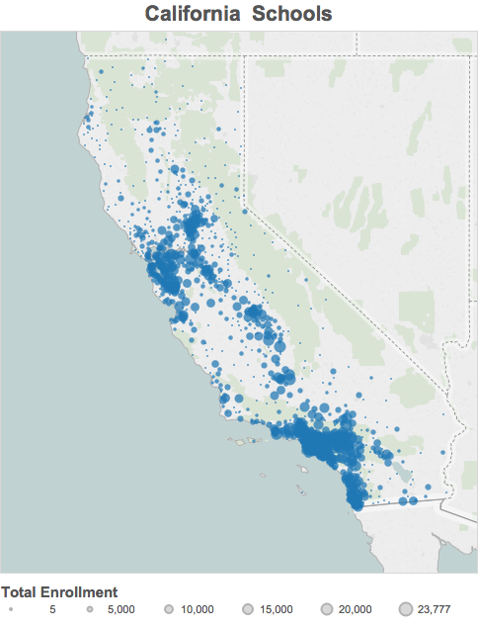
the data cleaning
To combine data from school, staff, and student level reports, I used pandasql, a package that allows you to query pandas DataFrames using SQL syntax. (See Python Notebook for code.)
The final data frame consisted of aggregated school data, with one row per school.
Remove nulls.
7,305 Schools

Slide 9
exploratory analysis

Slide 10
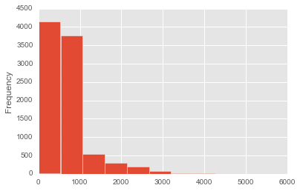
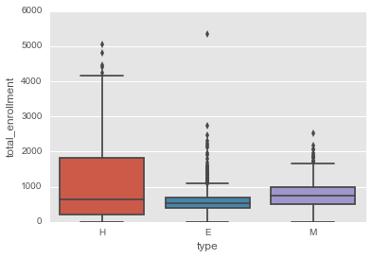
distribution - total enrollment

Slide 11
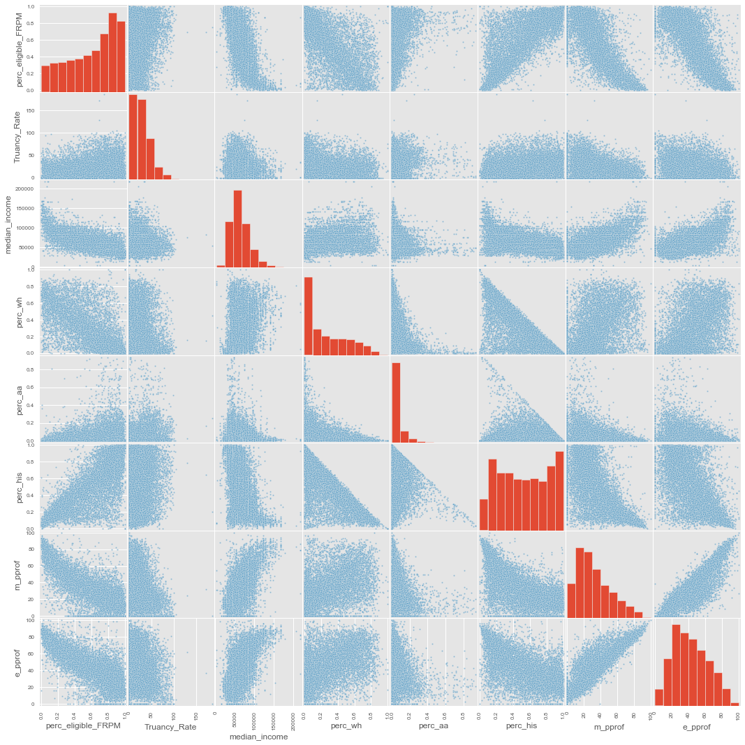
correlation
Neighborhood income highly correlated with race, free meal plan participation and proficiency.
Math proficiency and English proficiency highly correlated.
Charter schools had higher performance, but also higher median income and percent white

Slide 12
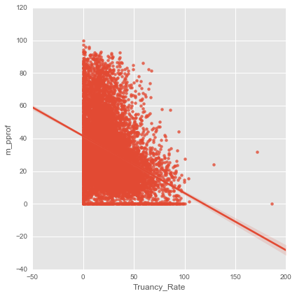
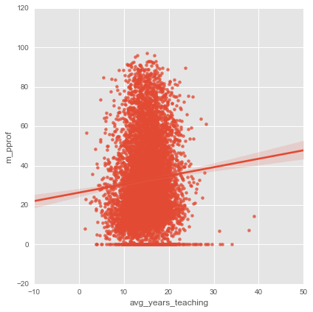
math proficiency as function of:
truancy rate
average teacher yrs experience

Slide 13
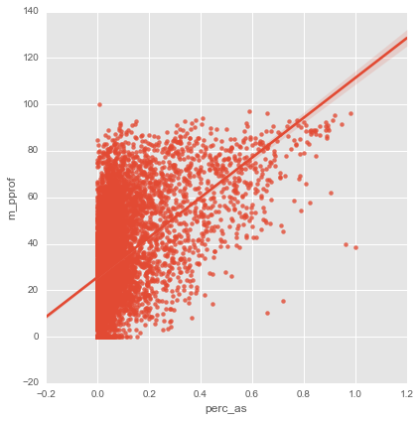
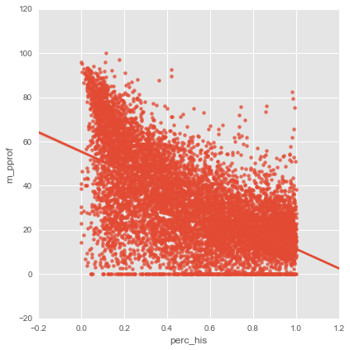
math proficiency as function of:
percent Asian
percent Hispanic

Slide 14
modeling

Slide 15
target variables
Regression: Percent of students proficient in math
Classification: Success= above average math proficiency and above average English proficiency. 40% of schools meet this criteria

Slide 16
feature engineering
Scale data using standardscaler
Create interaction variables

Slide 17
regression

Slide 18
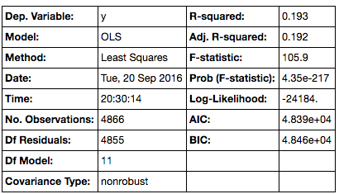
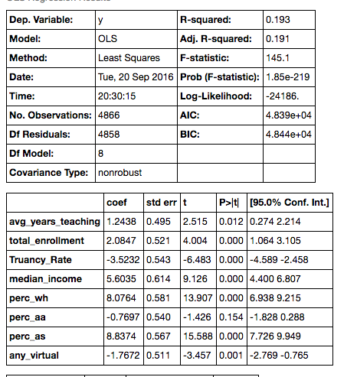
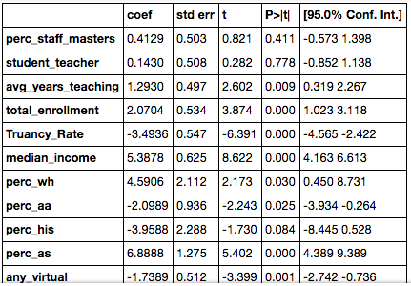
linear regression
All features
Trimmed features

Slide 19
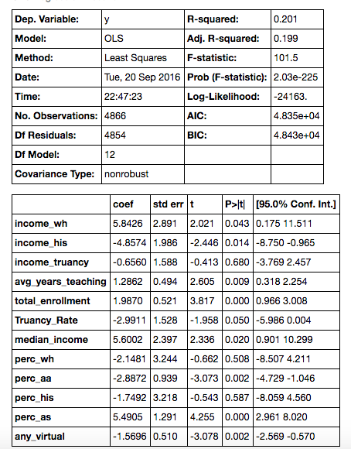
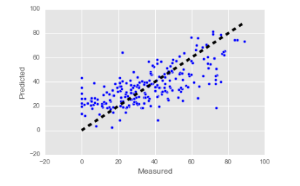
linear regression - cross validation
Trimmed features + interaction
Adding interaction features was the only adjustment that improved R-squared.
Final model had significant coefficients, good residual distribution, but very poor explanation of variance

Slide 20
classification

Slide 21
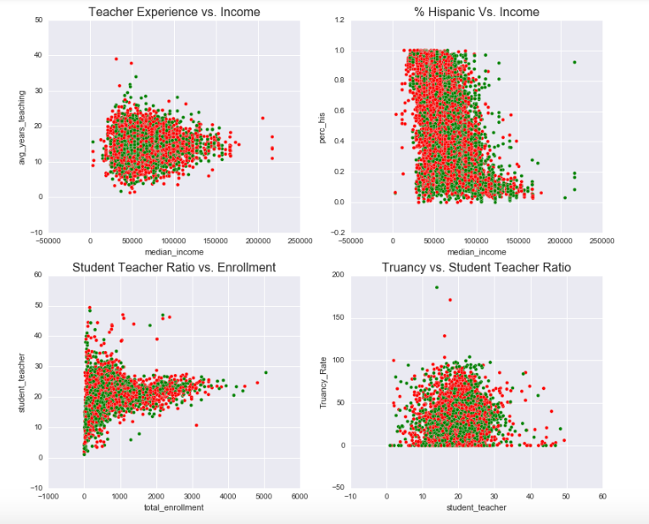
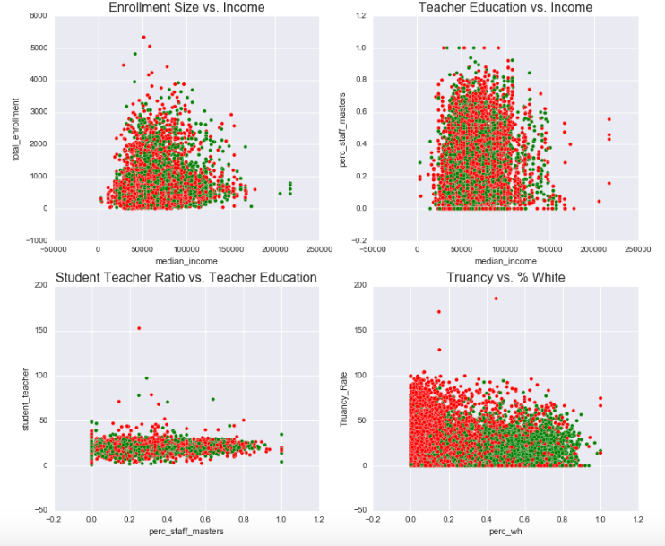
K-nearest neighbors
Green= success

Slide 22
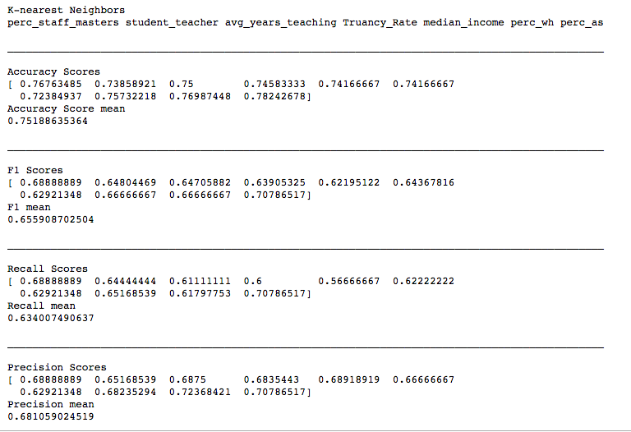
K-nearest neighbors

Slide 23
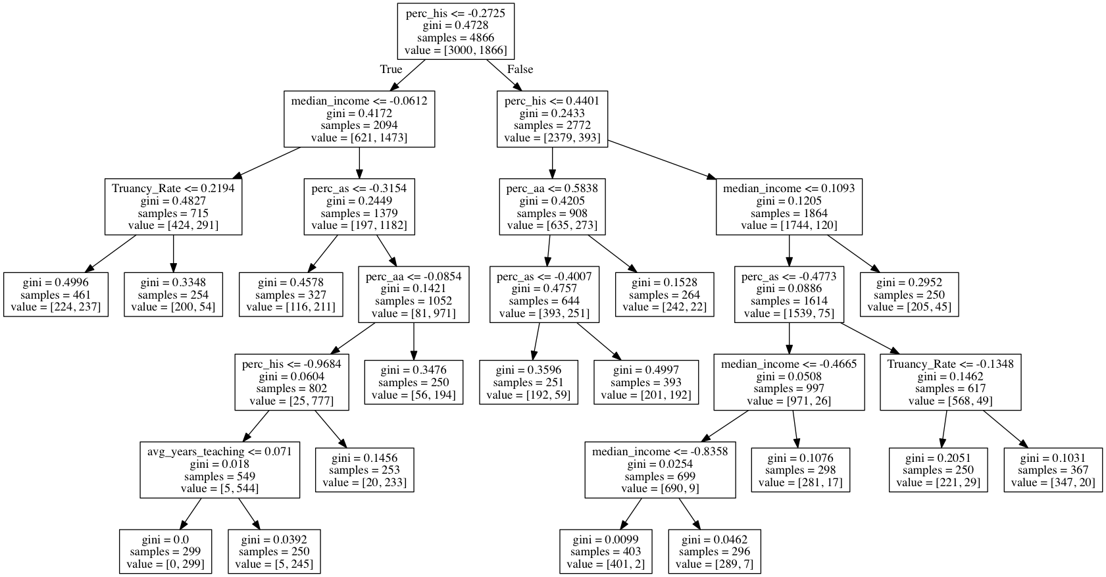
decision tree

Slide 24
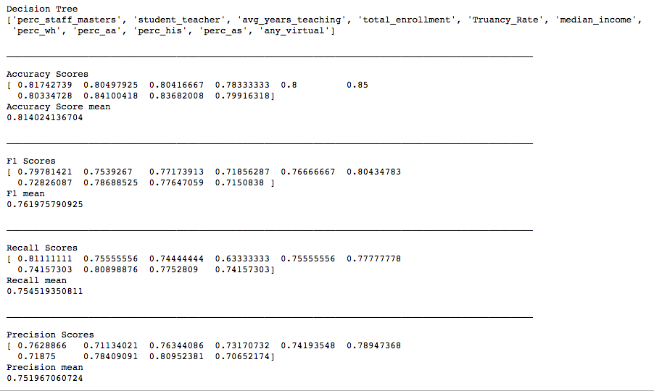
decision tree

Slide 25
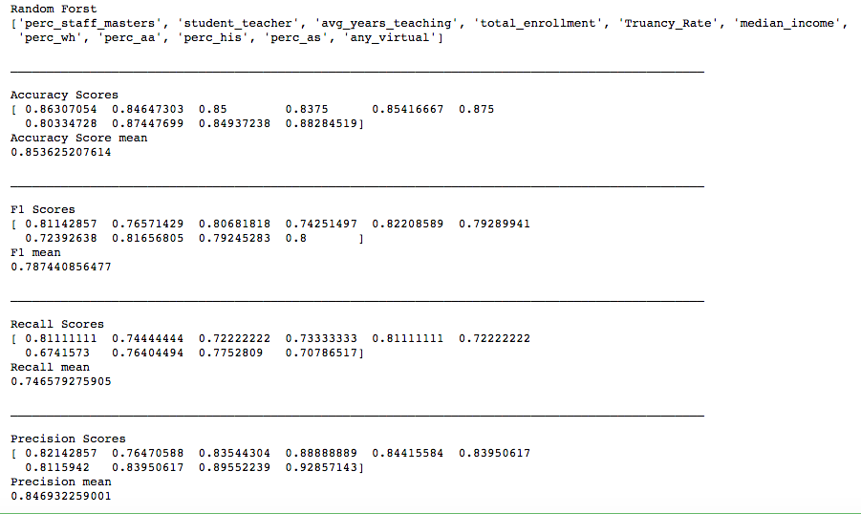
random forest

Slide 26
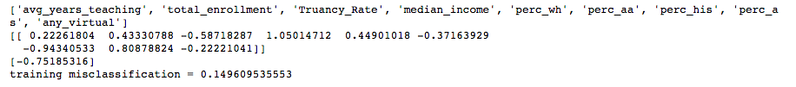
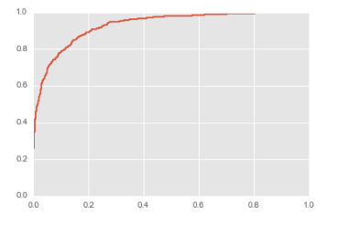
logistic regression
ROC Curve
Test Set Results:
Observed | False | True
False | 1351 | 195
True | 151 | 701

Slide 27
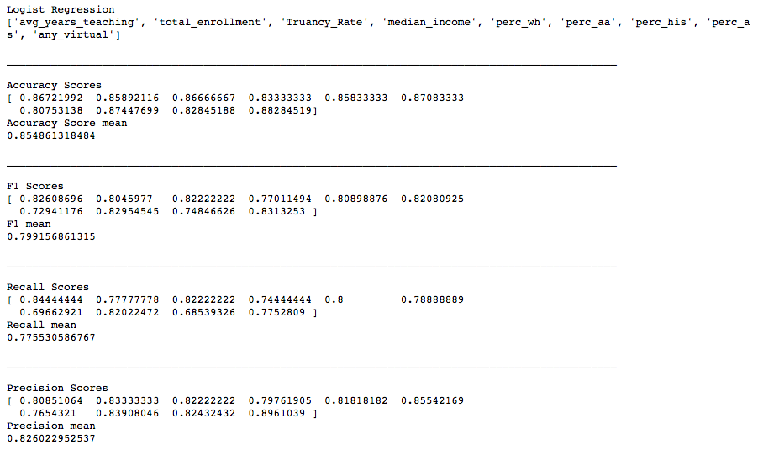
logistic regression

Slide 28
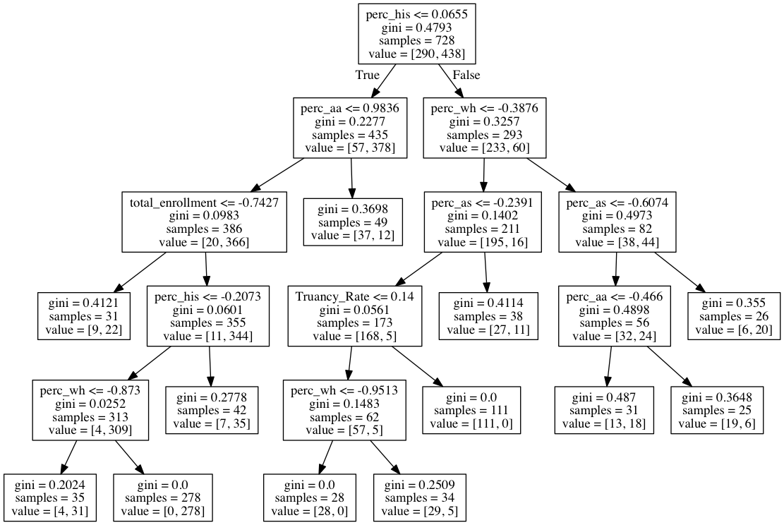
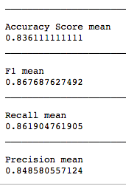
Bay Area deep dive

Slide 29
conclusion

Slide 30
conclusion
For schools, defining success is not easy.
Very interesting correlations.
In both the regression and classification analysis, demographic features proved more important than school features. One could either conclude that neighborhood resources and students’ home life has greater impact than the school itself, or that this dataset is missing the more important school features. I hypothesise that both are partially true.

Slide 31
next steps
Improve the model. Deal with NULLS. Examine data accuracy. Reduce multicollinearity.
More data. What other data could provide important school features? What do additional years of reports show?
A better measure of success. Some states look at student improvement rather than test scores.
More iterations. I would like to run the models for various groups, i.e high school vs. middle school, low income vs. middle income, without racial features

Slide 32
thank you!

Slide 33
appendix

Slide 34
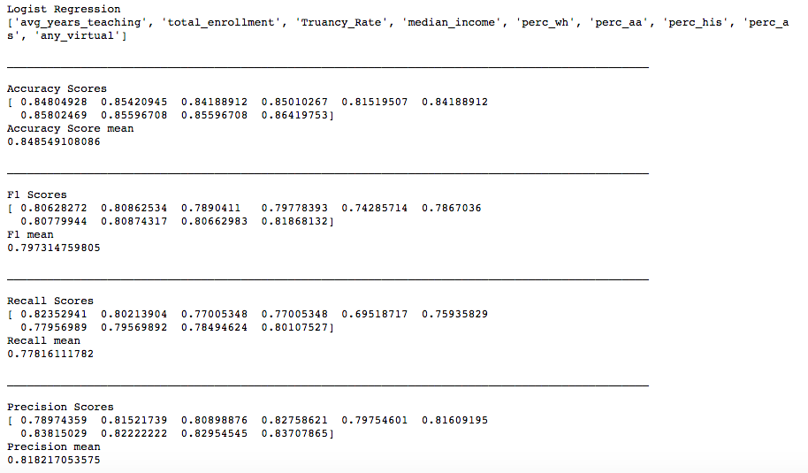
Logistic Regression - Training Cross Validation

Slide 35
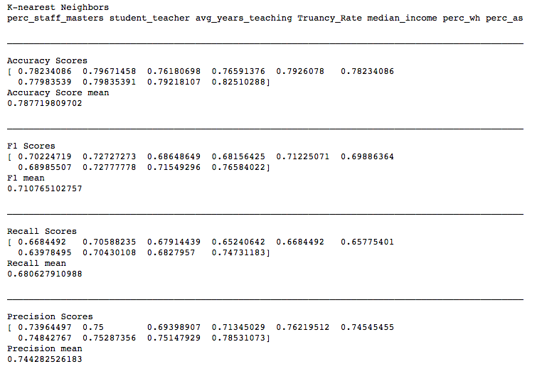
K-nearest Neighbors - Training Cross Validation

Slide 36
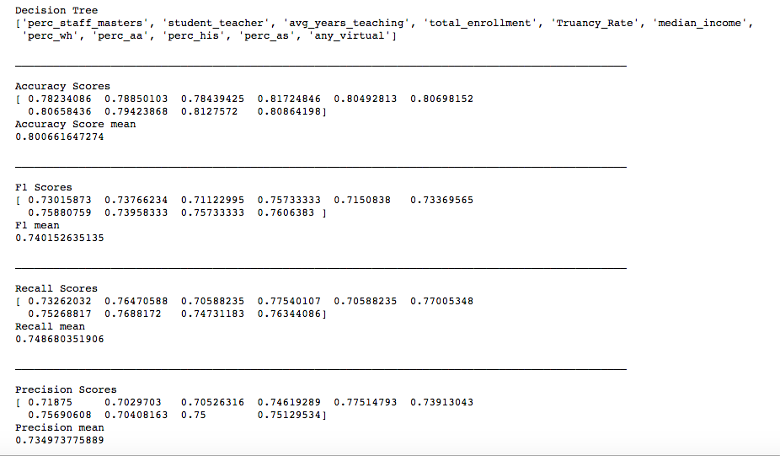
decision tree

